Slide 1


Popularity of Things
Measuring the popularity of security tools

Slide 2





Developers
Toni Perälä
: tperala21@student.oulu.fi
Juan Vazquez Moreno
: jvazquez21@student.oulu.fi
Marius Diamant
: marius.diamant@etudiant.univ-rennes1.fr
Sami-Peeter Laitinen
: sami-peeter.laitinen@student.oulu.fi
Customer
Rauli Kaksonen : rauli.kaksonen@oulu.f

Slide 3
What is it?
A program run from a Docker container that uses different API to get hit counts from Reddit, Twitter and Google Trends (using PyTrends)
Included also a custom hit count tool that gets up to 100 links from Google regarding that tool. eg. “Nmap” results in 99 links which we download
Source code is then scraped using pattern matching to look for home URLs regarding that tool to filter out irrelevant or undefined results (for example if a tool name is a general term such as Beef, Juicy-Potato or Volatility.)
Tool home URLs and names retrieved from YAML database provided by the client (We used 506 of these as some tools did not include home URL fields)

Slide 4
TOOLS WE USE
Python (libraries: BeautifulSoup 4, PyTrends, Praw, Twitter APIv2, Google Custom Search API)
Docker
Github
Everything run from a GNU/Linux environment

Slide 5
Tasks
Toni : Twitter API tool, YAML-db​, custom web-scraper
Marius : Reddit API tool, documentation, Matplotlib
Sami : PyTrends API for Google Trends, Google Custom Search JSON API (REST) for Google Search, web scraping​
Juan : Docker, Twitter API

Slide 6
TIMELINE FROM JIRA BOARD
3 Sep.
Group formed
4 Sep.
Client contacted and project selected
10 Sep.
First meeting with client, project tools initialized (Docker, Github, AWS)
15 Sep.
Began research phase
30 Sep.
Tools chosen, testing begins
15 Oct.
Began development phase
22 Oct.
JSON lists for popularity from different API
13 Nov.
Test around with eliminating and qualifying terms for the API
29. Nov.
Web Scraper development begins
27 Nov.
Higher tier license for Twitter API acquired
10. Dec.
Assemble Docker images
13 Dec.
Final tests

Slide 7
Google
Trends
Data is fetched using unofficial Google Trends API, pytrends.
It is used to request interest over time, timeframe last 7 days to present.
range of results are 0-100 and relative (not absolute), most popular at 100 and least at 0, rounded to integers precision.
Google trends anchor bank (GTAB, utilizes pytrends to get data) would increase the precision and universal scale by calibrating the data (simply put).
But there's a problem: results with these tools were questionable at the very least. The probably reason can be related to the candidate list that is used to generate the anchor bank. Candidate list can contain items between 500 to 5000. Original candidate list provided in library has items only related to drinks and foods... And eventually we had to discard it because creating a new candidate list would have been too time consuming and the results would be uncertain.
Custom Search JSON API
Official API is invoked by using REST for getting google search results. 10 items per query to a maximum of 100 items (10 queries per search term). Limit at 10000 queries per day, first 100 free and after that 5$ per 1000 queries.
Prerequisites: - Search engine ID - API key

Slide 8
Social Media API
Twitter API 2.0
Calls for Twitter "tweet" counts with Twitters hashtag search function
Query timeframe limited to 7-9 days according to Twitter
Limited to 300 queries per minute, extends execution time
"Qualifying terms" to eliminate non-relevant results proven to be slightly inaccurate – mc and die are considered to be general terms and vastly outweigh other results, even with qualifying terms
Reddit API
Extracts data from Reddit submissions
Title, submission text/description and upvotes, comments are checked with weighing based on count of likes
Check if the qualifying terms are present in the submission title or description, or in the comments Add the upvote count of submission or the comment of the query is present
Shares similar problem as with Twitter – general solution would be to consider general terms and to eliminate them from the search pool

Slide 9
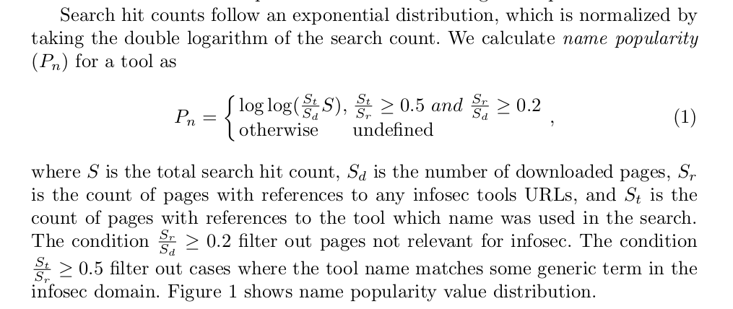
Name Hit Count – Web Scraper
Pattern match from page source
Add to results if filters passed
Source: Kaksonen, Rauli; Järvenpää, Tommi; Pajukangas, Jukka.
http://jultika.oulu.fi/files/nbnfi-fe2021100149105.pdf

Slide 10
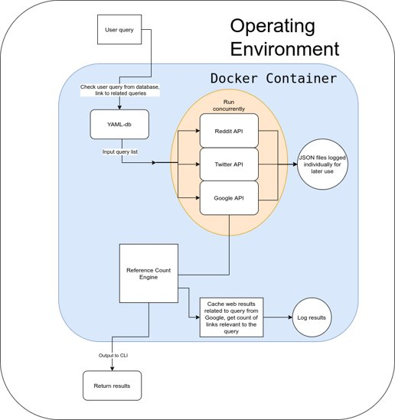
Containers can be run concurrently as they have no dependencies on one another

Slide 11
Problems
API limitations (Twitter max 300 queries per 15 minutes, Reddit elimination terms difficult for Reddit to understand (die and mc general terms referring to other things than security but are still tagged when looking for results in the security/computer science field.)
Execution time is long for the web scraper - 4 hours to download all links and to analyze the data (test run from Docker container running in an environment with a 4-core Intel i5 4690K 4.2GHz CPU)
Multiprocessing used for scraping slows down host system
Getting links from Google currently done iteratively without threads because of Google Custom Search API limitations (For instance, 429 Too many requests. Retry strategy https://cloud.google.com/storage/docs/retry-strategy#exponential-backoff)

Slide 12
Results
-Results from custom made name search web scraper relatively accurate
- Some popular tools eliminated and a few irrelevant terms passed the filter, making a tool seem more popular than it actually is (eg. “John” referring to John the Ripper). Need to run more tests with different pattern matching methods (current version only looks for any pages that start with the home url, for example we get a hit when looking for wireshark.org and get https://blog.wireshark.org/ to get more hits
-Results from Twitter, Reddit and Pytrends share the same issue; even with qualifying terms to narrow down results, inevitably there will be irrelevant terms in the results. Such as "mc" or "die". General terms then eliminated from .json files manually

Slide 13
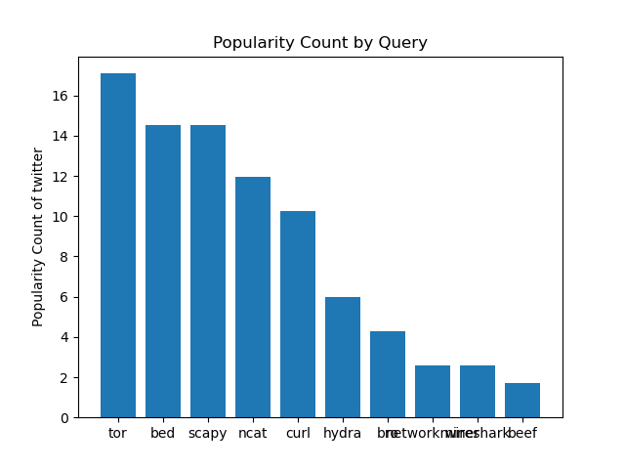
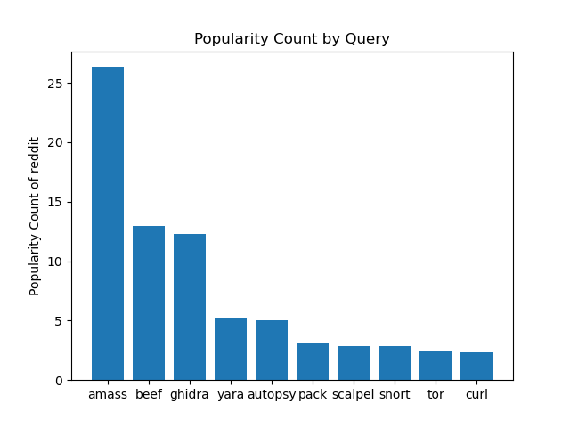
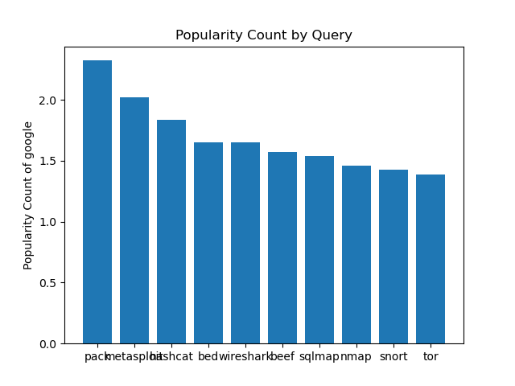

Slide 14
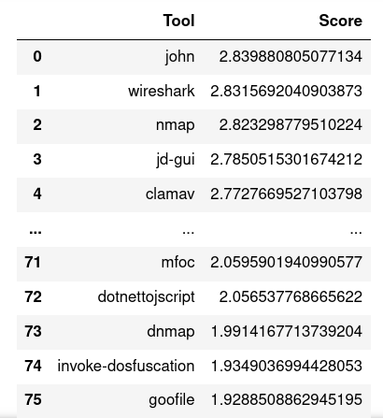

Slide 15
Future implementation, fixes
Implement another metric, cross-reference count to check for mentions on other pages
Some general terms still pass through the filters - could adjust scores to test for different results
Web scraper: API not available for public use as Google Custom Search API costs 0.05 cents per query for every query over 100 queries/day.
Tools split into two containers so can be run concurrently if wanted
Twitter API tool removed as it contains a personal access key for Twitter APIv2
Source code available at (github repo here) for anyone to modify, distribute and use the software (GPLv2 license)
Expand functionality to other things, not just security tools

Slide 16

Q&A

